Slide 1

Jenkins Periodic Projects Load Analyzer & Balancer Plugin
Omar Y. Tahboub
Fusion Team
Global Platform & Infrastructure (GPI)
eBay Inc.

Slide 2
Introduction
In the last 5 year Jenkins Continues Integration (CI) platform has been widely applied in enterprise-level software development.
Jenkins CI provides an end-to-end pipeline starting from source code checkout to unit testing and code coverage reporting.
Jenkins CI is applied by three main customers:
Application Developers.
QA Engineers.
Release Management (RM) Engineers.

Slide 3
A Brief Look into Jenkins CI Architecture
Users submit build requests through the Jenkins CI platform to build various types of projects.
Builds are performed on a common farm of build machines (can range from COTS nodes to high-end servers such as HP DL980s)

Slide 4
Build Farm Contention
Due to the centralized nature of the Jenkins CI platform, all builds are sharing a common build farm.
When the build farm is comprised of leased high-end servers, computation resources are expensive.
The more frequent the build is performed the more computation resources in the build farm.
Mostly resulted by periodical build projects.
When builds are irrelevant or aimless, they unnecessarily consume valuable computation resources.
Causes substantial long builds queuing times (in hours sometimes).
Cause other (more important) builds to starve.

Slide 5
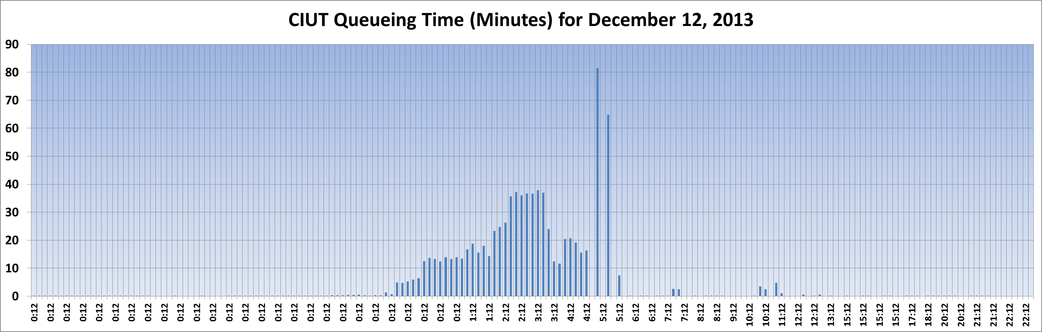
Impact of Build Farm Contention
When build requests are profiled over the day, build frequency can be higher in some hours more than the rest.
These high frequency periods are called hot spots.
Hot Spot
Hot Spot

Slide 6
Addressing Build Farm Contention
There several solutions to this critical problem:
Add more resources (Very expensive sometimes).
Educate users to avoid building during the hotspots hours (impractical most of the time due to lack of user compliance).
Alleviate the impact of periodical jobs:
Manually spreading the periodical jobs.
Devising a custom Groovy Script to modify time trigger in periodical projects.
Devising a special purpose plugin to analyze and automatically balance periodical jobs.

Slide 7
Alleviate the Impact of Periodical Projects – Solution (1)
Manually spreading the periodical jobs:
Requires manual analysis of builds over a span of week.
Determine the hotspots and the builds running during these hours periodically.
Modifying the time triggers of these jobs manually.
Very tedious and very time-consuming (could take days not hours)

Slide 8
Alleviate the Impact of Periodical Projects – Solution (2)
Devising a custom Groovy Script to modify time trigger in periodical projects:
Pros:
Provides a configurable automation for modifying time triggers for periodical jobs.
Fast (would take minutes instead of days).
Cons:
Requires advanced knowledge of Jenkins CI core along with some knowledge of Groovy.
Complex, especially when periodic job scheduling is based on multiple rules for midnight, hourly, daily and high frequent periodical builds patterns.
Stateless, won’t track the previous state of the periodic jobs.
Lack of visualization
Can be unsafe since the script could access the Jenkins instance in memory.

Slide 9
Alleviate the Impact of Periodical Projects – Solution (3)
Devising a special purpose plugin to analyze and automatically balance periodical jobs.
Pros:
Provides a configurable automation for modifying time triggers for periodical jobs.
Fast (would take minutes instead of days).
Easy to use, no advanced knowledge is required.
Provides visualization for load analysis.
State-ful, can maintain the previous state of the periodic projects.
Would be easy to revert to the previous time trigger in case a miscalculation is done
Multi-Aspect, can address multiple aspects of build load imposed on periodic projects such time distribution, project listing, load-balancing strategies.
Can be benefited by the Jenkins Community as an Open Source plugin.
Safer: Since user won’t have a full access to the Jenkins instance.
Cons:
The requirement of permanent memory, since the plugin and the periodic projects state information will reside in the memory
Can be a BIG issue if it is poorly designed around preventing memory leaks.
Harder to develop than writing a script.

Slide 10
Proposed Solution
With being memory-cautious, the plugin option seems to be more appealing.
A special purpose plugin is developed to address the load posed by periodical projects, which performs the following:
Calculates and plots the distribution of periodic builds in the span of 24 hours.
Provides a detailed listing of periodical projects in any given Jenkins CI instance.
Provides a configurable tool for balancing periodic projects.

Slide 11
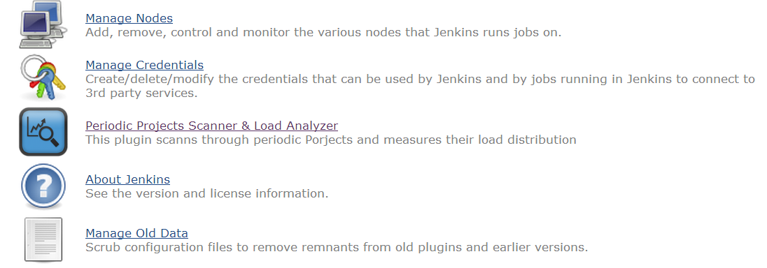
The Plugin
This plugin is only is used by the Jenkins administrators.

Slide 12
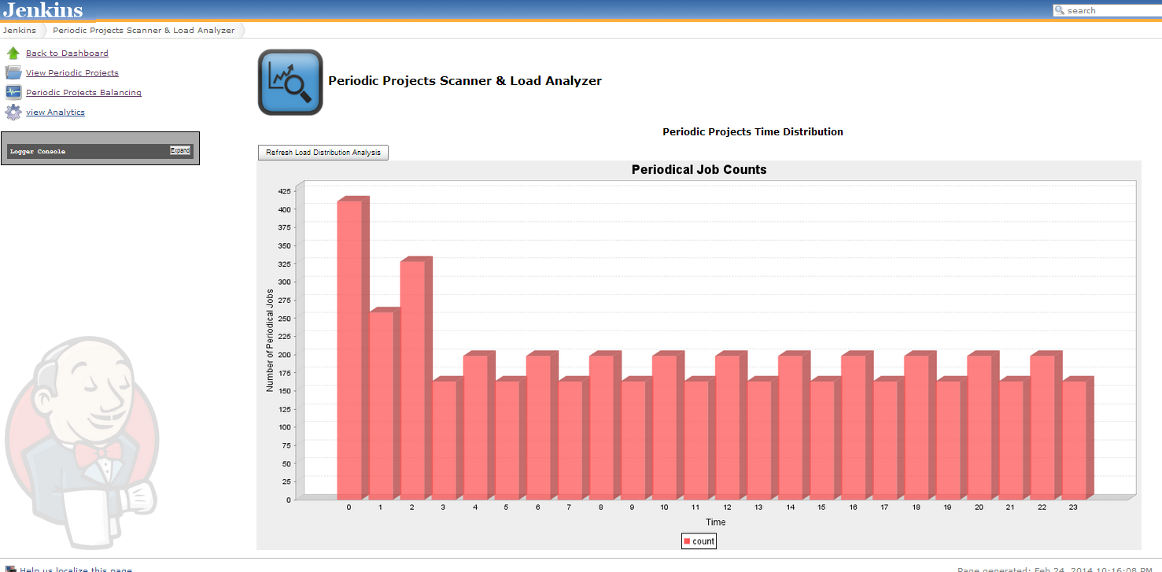
Periodic Projects Load Distribution
Hot Spot Hours (12:00 AM – 3:00 AM)

Slide 13





Periodic Projects Listing
We classify periodic projects as follows:
Symbol | Frequency | Number of builds every day
 | Low | Less than 7 builds
 | Medium Low | Less than 13 builds
 | Medium High | Less than 25 builds
 | High | Less than 37 builds
 | Very High | Less than 49 builds
 | Extremely High | More than 49 builds

Slide 14
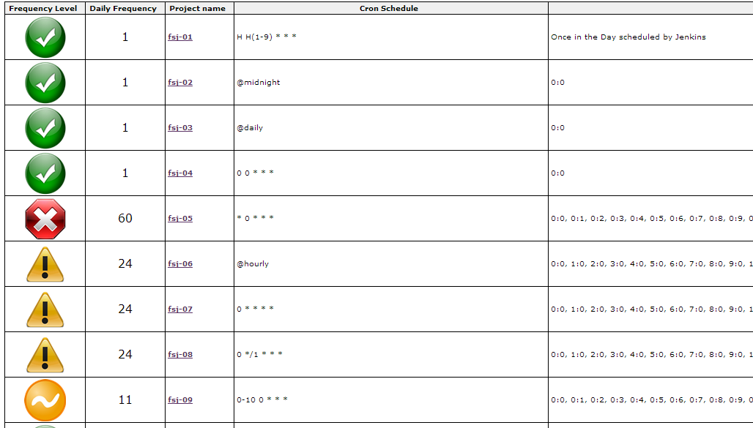
Periodic Projects Listing

Slide 15
Types of Periodic Projects Addressed
The following are types of periodical projects are handled:
Midnight: All jobs that only builds at midnight.
Hourly: All jobs that build once every hour.
Daily: All jobs also build every day at midnight.
Multiple Times every hour: All jobs that build multiple times every hour.
Multiple times in different hours: All jobs that build multiple times in different hours during the day.

Slide 16
Periodic Projects Balancing
When the load distribution is calculated, the Jenkins admin apples the following :
Midnight and Daily Balancing Heuristic:
Time balancing window Policy: The time span where midnight jobs are going to be spread.
Hourly Balancing Policy Balancing Heuristic:
Hotspot Avoidance Policy: This plugin calculates the top three hours in terms of build load resulted by periodic projects.
Frequency within the Hour Reduction Factor: the percentage by how much the build frequency is reduced in the given hour.
Hourly Frequency within the Day Reduction Factor: the reduction percentage of how many hours in the day the job will be building.

Slide 17
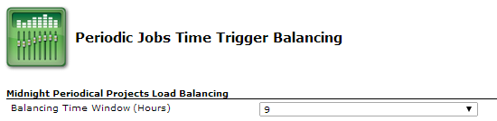
Time Balancing Window Policy
Spreads out the projects building during the midnight hour over the time window (3, 6, 9, 12).
Within the given time window the project will be assigned to the hour where the minimum number projects are assigned.
In the Jenkins 1.5x, midnight projects can be converted to the Hash cron expression such as : H H(s-e) * * *
s is the start hour and e is the ending hour in the time window.
Would only work when balancing periodic projects that only runs once in the day such as (@midnight, @daily).

Slide 18
Hotspot Avoidance Policy
This plugin provide three hotspots avoidance options:
Midnight Only: will only balance all jobs that build during the midnight hour.
Hotspots Only: Will only balance the jobs that are building during the hotspot hours:
The plugin currently detects the top 3 hotspots excluding the midnight hour.
Hotspots plus Midnight: Will balance jobs that run during both hotspot hours and midnight.

Slide 19
Frequency within the Hour Reduction Factor
This option reduces the project build frequency within the hour either by: 25%, 50% or 75%.
For instance if the project builds every 10 minutes, and the reduction factor is 50%, it would build every 20 minutes instead.

Slide 20
Hourly Frequency within the Day Reduction Factor
This option reduces the number of hours within the day the project would build. either by: 25%, 50% or 75%.
For instance if the project builds every 2 hours every day, and the reduction factor is 50%, it would build every 4 hours instead.

Slide 21
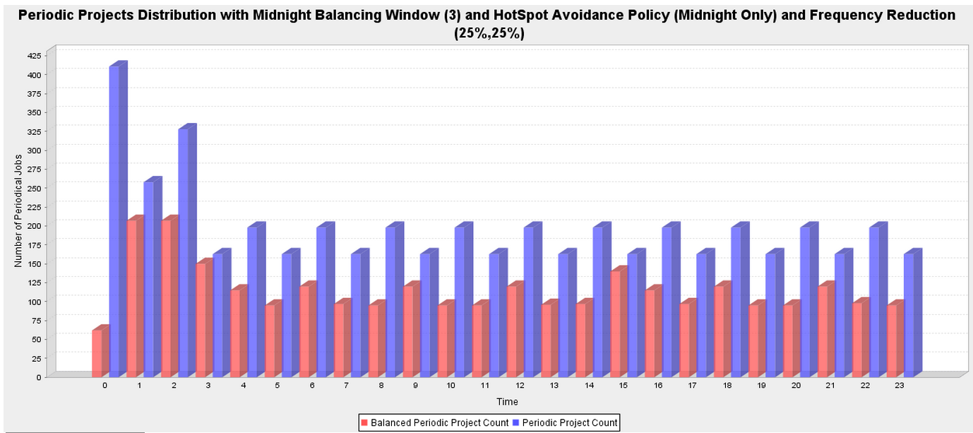
Preview the calculated balanced Periodic Projects
Prior to balancing the periodic project this plugin provides a preview distribution plot.

Slide 22
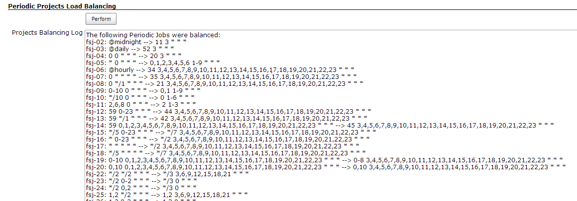
Balancing Periodic Projects
After the administrator approves the new load distribution, the actual balancing can take a place.
By clicking on the (Perform) button, it will apply the balancing options on the set of unbalanced periodic projects in the Jenkins instance.

Slide 23
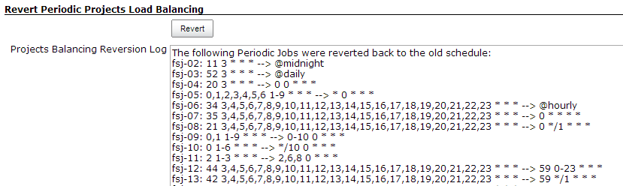
Reverting the Balancing of Periodic Projects
In case the administrator finds out that there was mistake in selecting balancing policies or options.
By clicking on the (Revert) button, it will undo the balancing options on the set of balanced periodic projects in the Jenkins instance.

Slide 24
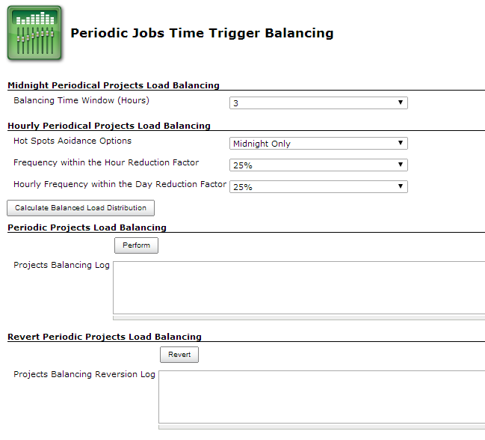
Putting all Together

Slide 25
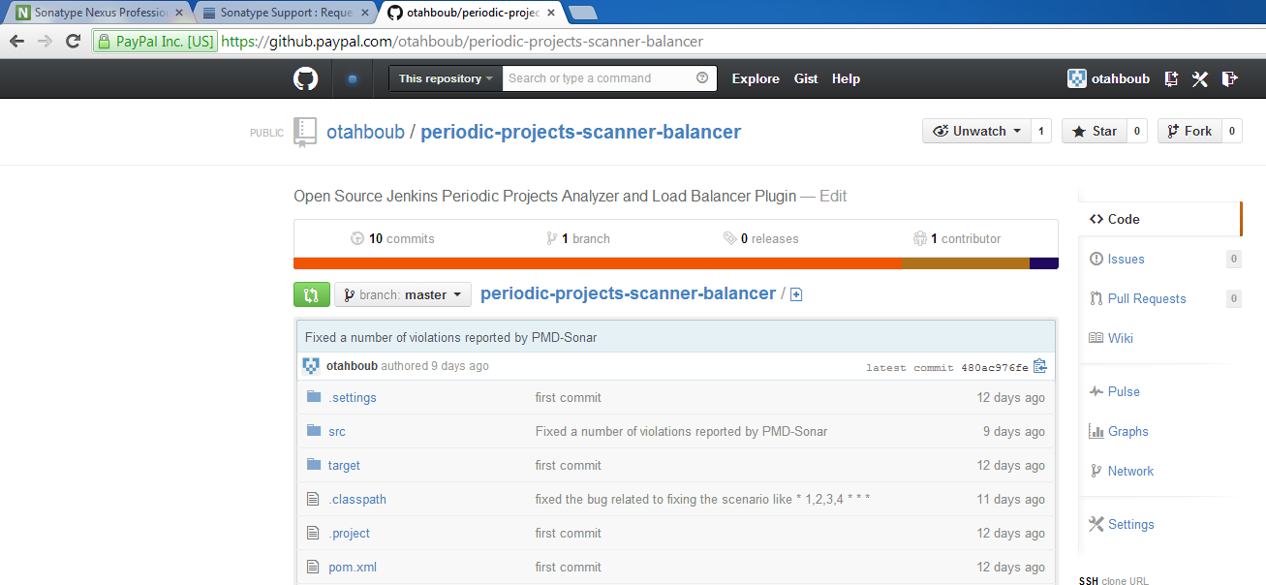
The Code Repository
https://github.paypal.com/otahboub/periodic-projects-scanner-balancer

Slide 26
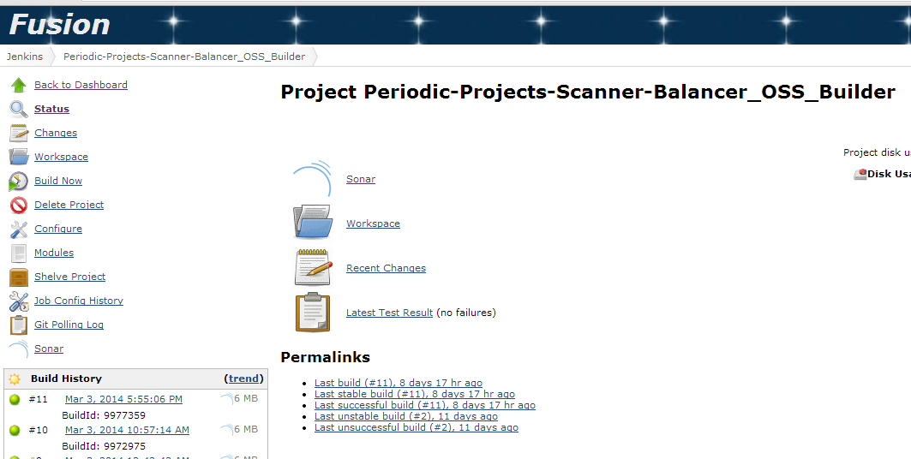
Fusion Builder Job on QA
https://fusiondev.paypal.com/jenkins/job/Periodic-Projects-Scanner-Balancer_OSS_Builder/

Slide 27
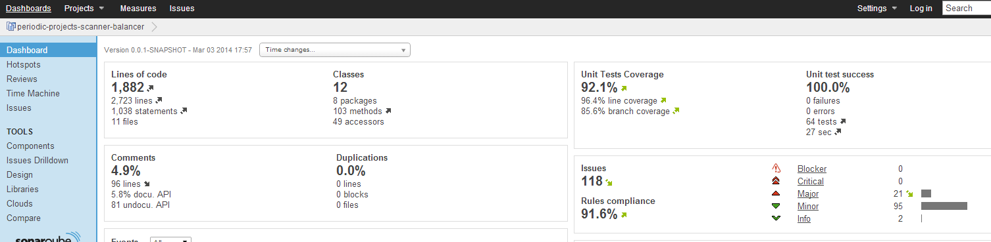
Sonar Coverage Report
http://fusionweblvs01.qa.paypal.com:8090/sonar/dashboard/index/com.paypal.jenkinsci:periodic-projects-scanner-balancer

Slide 28
Future Extensions
This plugin will be released as an Open Source contribution to the Jenkins community.
There are still more features could be added in future releases:
Exclusion List.
Periodic load balancing automation (periodic task).
Project Configuration UI integration: show the user a heat map of the periodic build load distribution.

